Slide 1
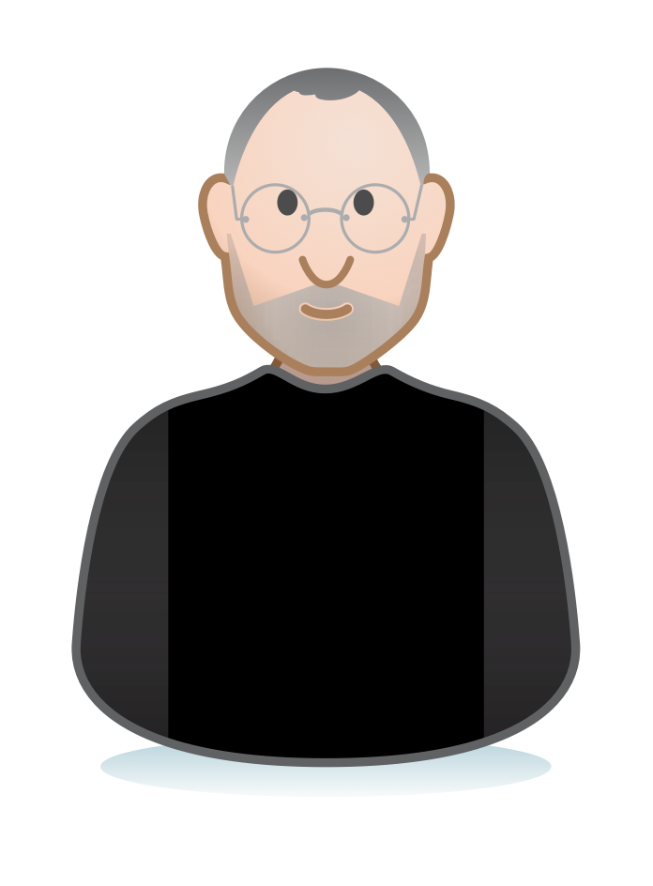
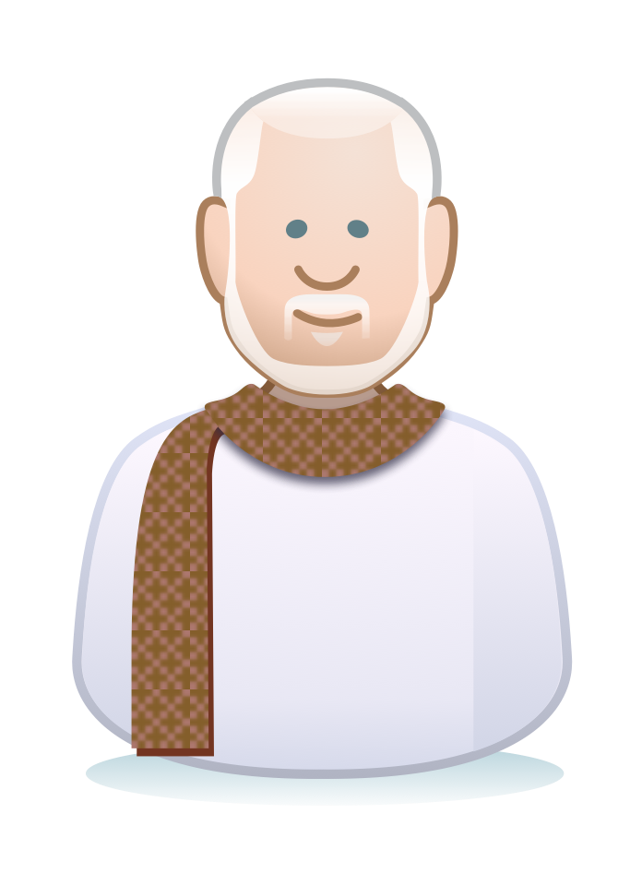
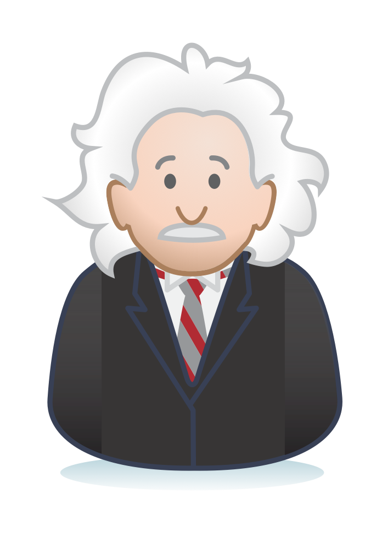
UX PEOPLE
The UX PEOPLE stencils help you incorporate more realistic people for better, more humanized diagrams.
To use, simply drag or copy and paste characters from this template onto your presentation and resize as needed. Enjoy!
Also available in alternate formats:
> OmniGraffle stencils: http://j.mp/uxpplstencils > Axure RP stencils: http://j.mp/uxppllib
> LucidChart template: http://j.mp/uxppllc
Illustrations by Jeffery Callender
Template by Livia Labate

Slide 2
INDIVIDUALS

Slide 3
GROUPS

Slide 4
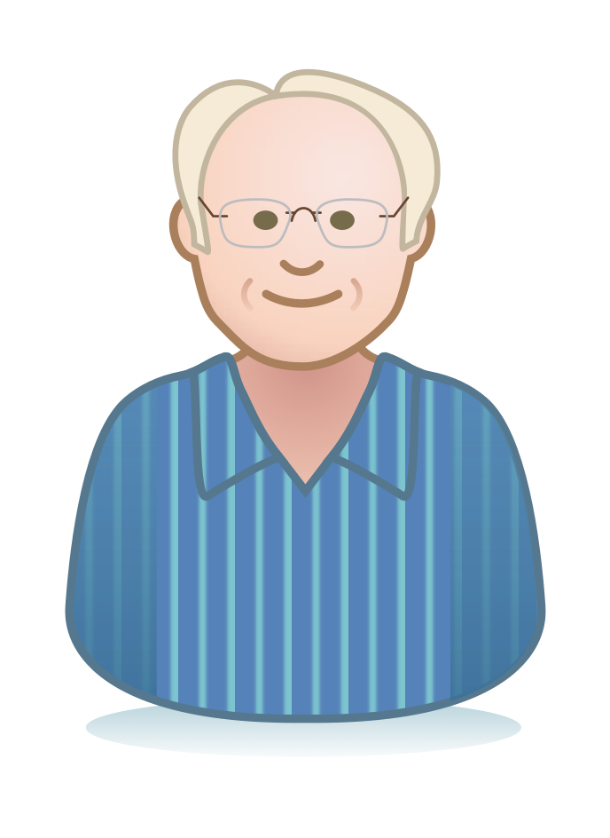
PERSONALITIES
Thank you for encouraging my behavior!
Notes:
From the top: Jared Spool, Jesse James Garrett, Richard Saul Wurman, Albert Einstein, Steve Jobs, Kristina Halvorson, Jacob Nielsen, Whitney Hess.

